Slide 1
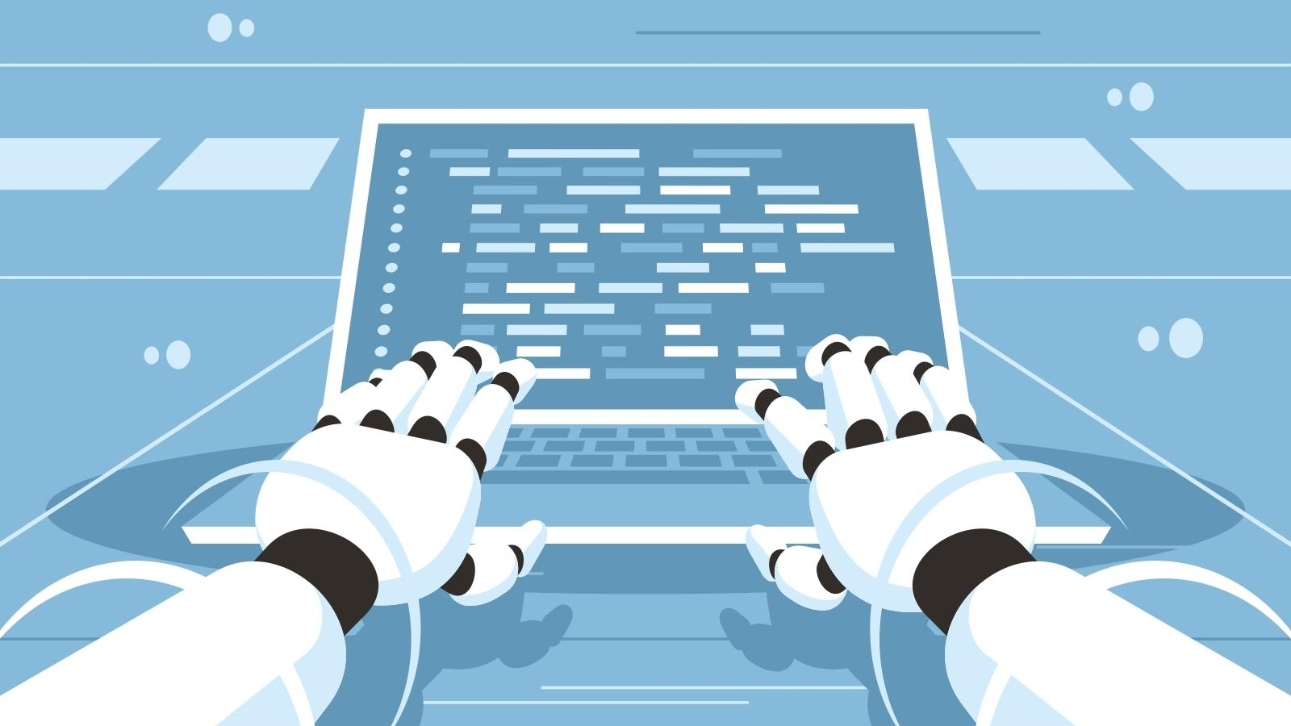
Exploration of Employment in the U.S
GROUP 8: ABDULLAH “AB” IBRAHIM, ALBWIN “AL” WAGNER-SCHMITZER, EDILBERTO “DEL” VINAS, JAY HOWARTH, CRYSTAL WHITE

Slide 2
EXECUTIVE SUMMARY
Project Overview
Questions we answer:
What does the BLS employment data say about the industries who employ the highest number of computer scientists?
For those industries who employ the highest number of computer scientists, what does overall employment look like (past, present, and future) for them?
For those industries, which ones are growing faster, adding the most full-time jobs (in real numbers) and have the greatest employment stability?
Beyond the BLS data, what additional information can we find related to employment in computer science, specifically within artificial intelligence, to help us understand our ability to find and keep employment?
How We Approached the Project
How We Approached the Data Sourcing, Manipulation & Analysis
What We Learned
Conclusion
Remaining Questions for Future Exploration
References

Slide 3

HOW WE APPROACHED THE PROJECT
Notes:
Breakdown of our approach

Slide 4
READY, FIRE, AIM
Project review
Discussion of data sources & decision on BLS
Project timeline & outline
Tutoring session & initial pull of BLS data
Deeper data review & pivots
Illustrative examples of story we could tell (initial presentation creation)
Selection of specific types of data
Coding, testing, GitHub load, rinse, wash, repeat
Securing outside help
Revising code
Documentation (ReadMe)
Final analysis & presentation refinement

Slide 5

HOW WE APPROACHED THE DATA SOURCING, MANIPULATION & ANALYSIS
Notes:
Breakdown of our approach

Slide 6
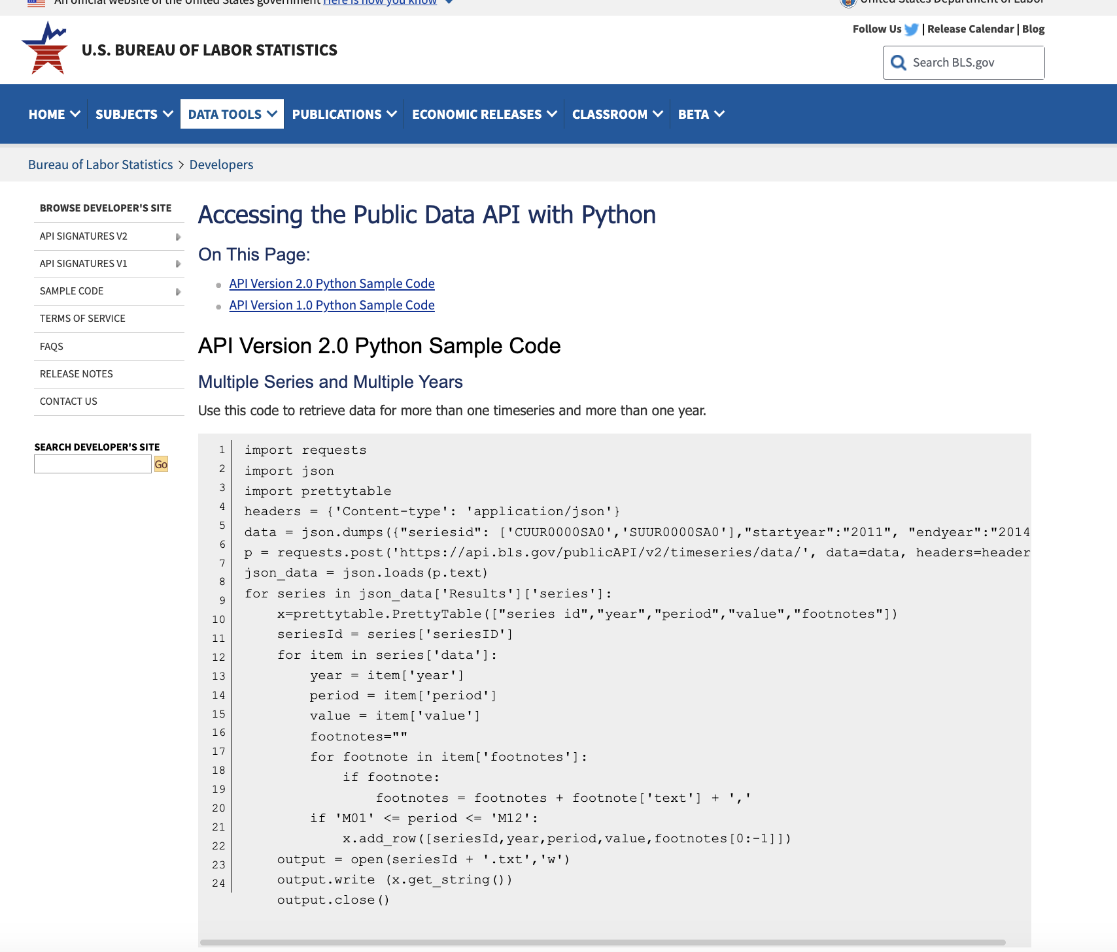
GETTING OUR HANDS ON SOME, BUT NOT TOO, MUCH DATA
The Approach
URLs for initial analysis: https://www.bls.gov/help/hlpforma.htm
API access: https://www.bls.gov/developers/api_python.htm
Breaking down code, data merges & manipulation, data visualization
Pivot: Computer science roles for multiple NAICS + Job data for AI-related roles
Sourcing supplementary information (reports and outside support)
Source: Bureau of Labor Statistics (2023)

Slide 7
Code Snippet Overview
Imports the required libraries, including Prophet, and matplotlib for plotting.
Renames columns in the DataFrame to match Prophet's expected format.
Prepares the data for modeling.
Creates a Prophet model and adds seasonality.
Fits the model to the data.
Generates a future Dataframe for forecasting.
Makes a forecast using the trained model.
Visualizes the forecast and its components using matplotlib.

Slide 8
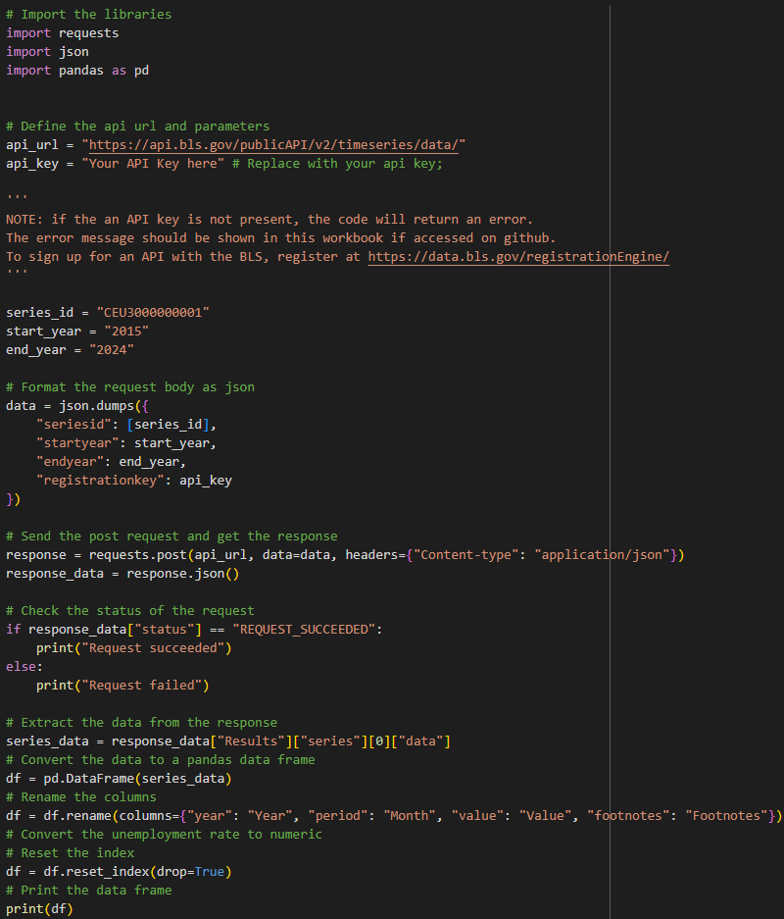
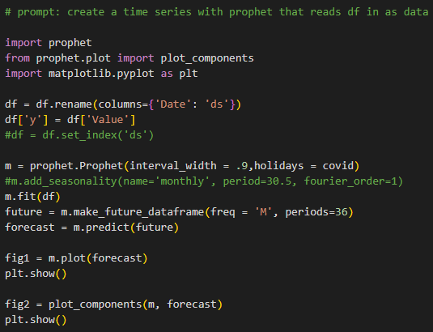
Code Snippet screenshots

Slide 9

WHAT WE LEARNED
Notes:
Breakdown of our approach

Slide 10
“The human talent deficit is the government’s most conspicuous AI deficit and the single greatest inhibitor to buying, building, and fielding AI-enabled technologies for national security purposes.
This is not a time to add a few new positions in national security departments and agencies for Silicon Valley technologists and call it a day.
We need to build entirely new talent pipelines from scratch
(The National Security Commission on Artificial Intelligence, 2021).”

Slide 11
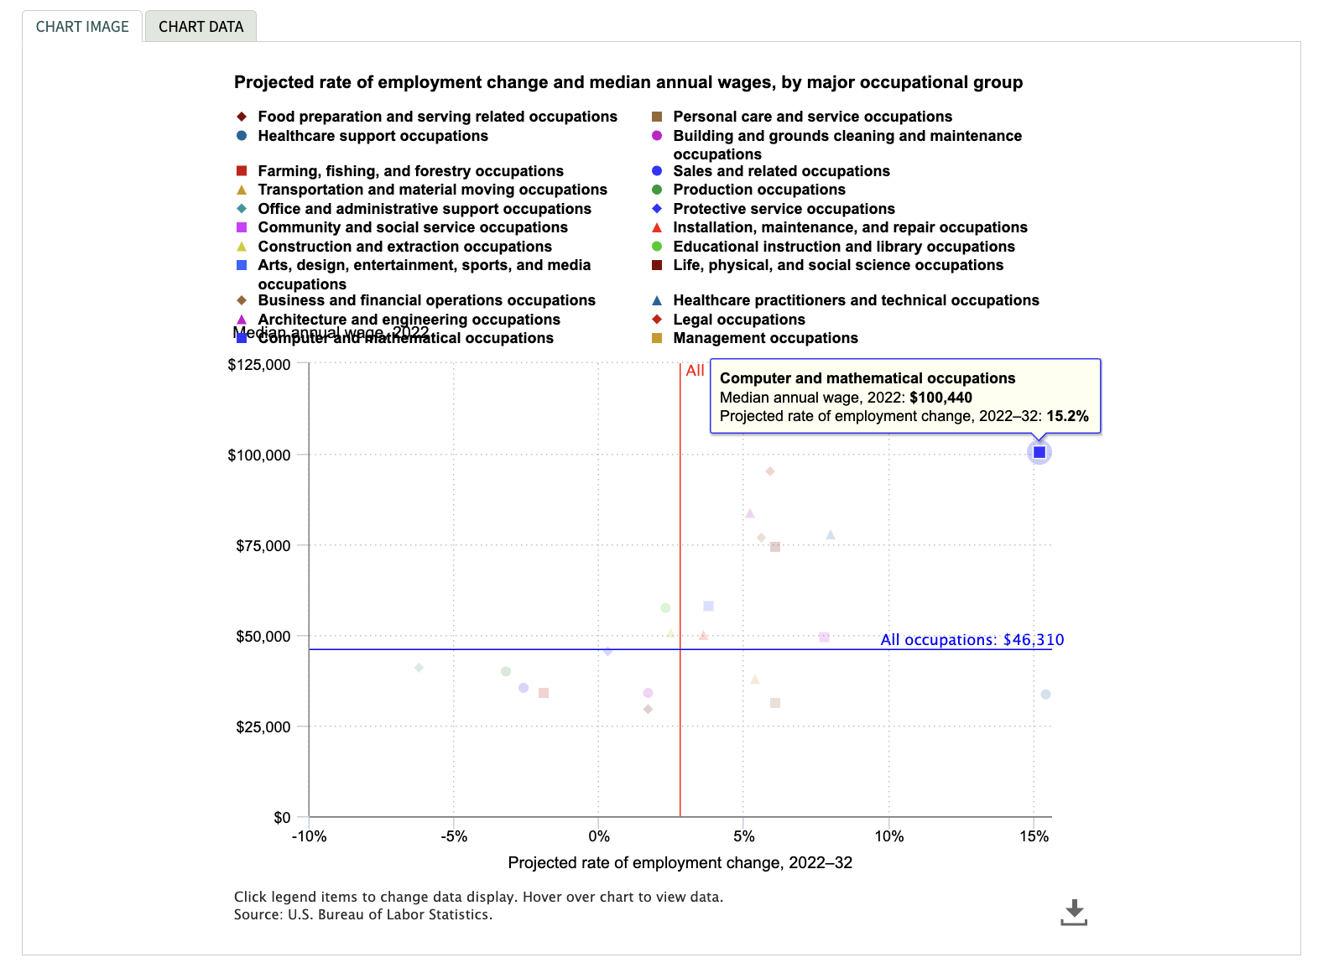
KEY FINDINGS FROM BLS DATA
At 15.2% expected growth, computer and mathematical jobs are the 2nd fastest growing industry, second only to healthcare support
But, at a median annual wage of $100,400, computer and mathematical occupations are 2-3x the other fastest-growing industries (healthcare support, healthcare practitioners, and social services)
Source: Bureau of Labor Statistics (2023)
Notes:
Computer and mathematical occupations (15%) & $100k median annual wage
Healthcare occupations (15%) & $30k median annual wage

Slide 12
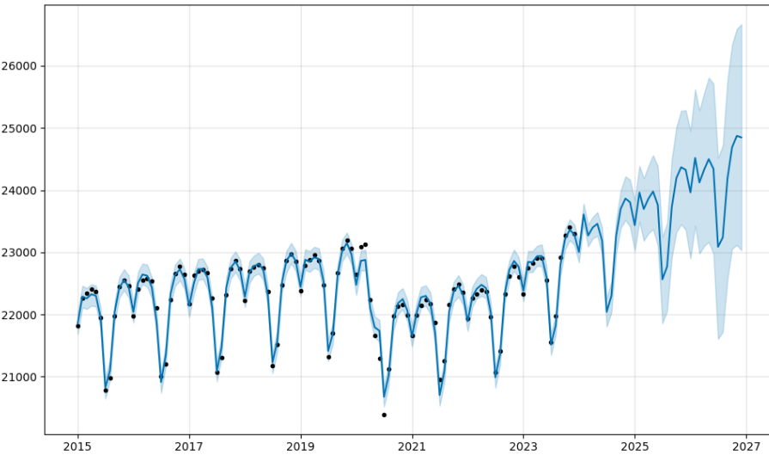
Government Employment Forecast
Analysis Highlights
Full-time employment in the government industry was trending slightly upwards until 2020 when COVID hit
Dropping to its lowest number of full-time employees since before 2015
Has not yet returned to pre-COVID levels
Employment
Year
*Data represented in thousands
Notes:
Computer and mathematical occupations (15%) & $100k median annual wage
Healthcare occupations (15%) & $30k median annual wage

Slide 13
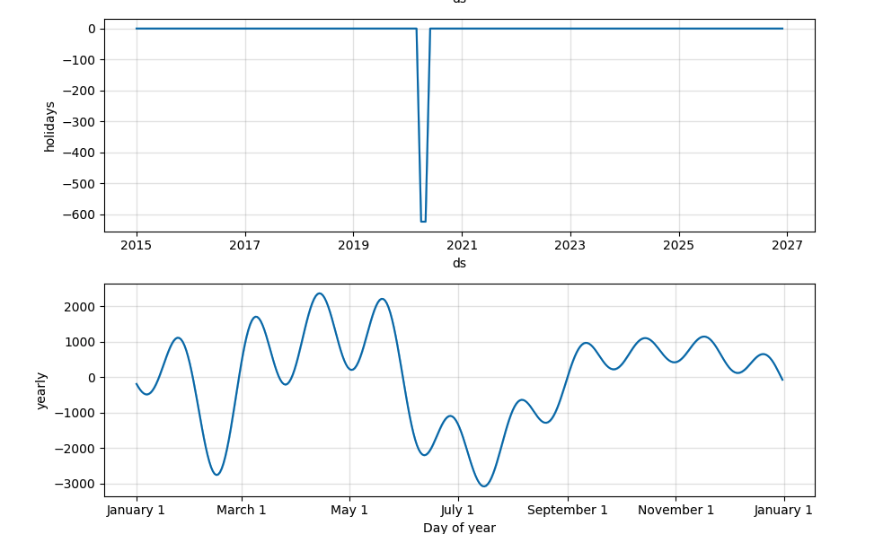
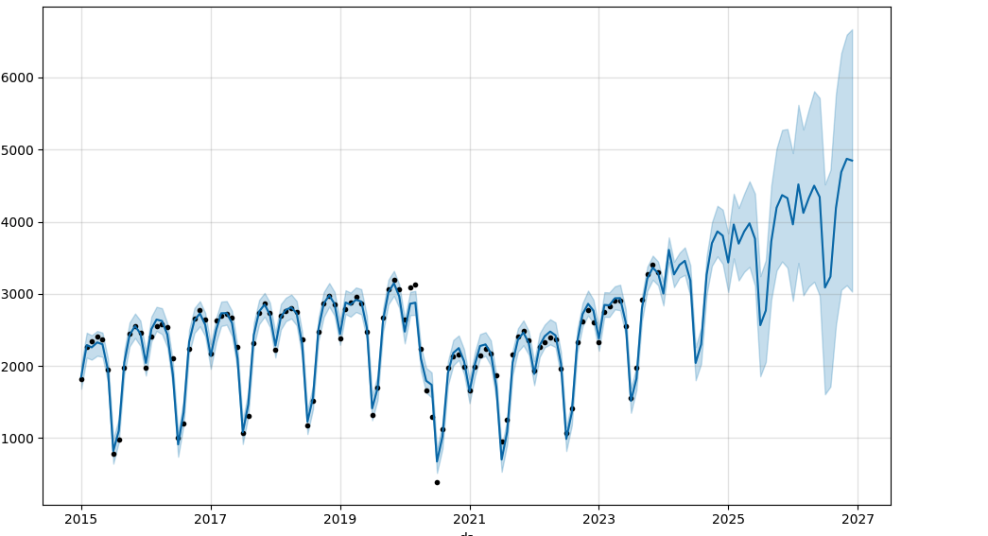
GOVERNMENT INDUSTRY
“AI is going to reorganize the world. America must lead the change.” -NSCAI
Source: Bureau of Labor Statistics (2023)
*Data represented in thousands

Slide 14
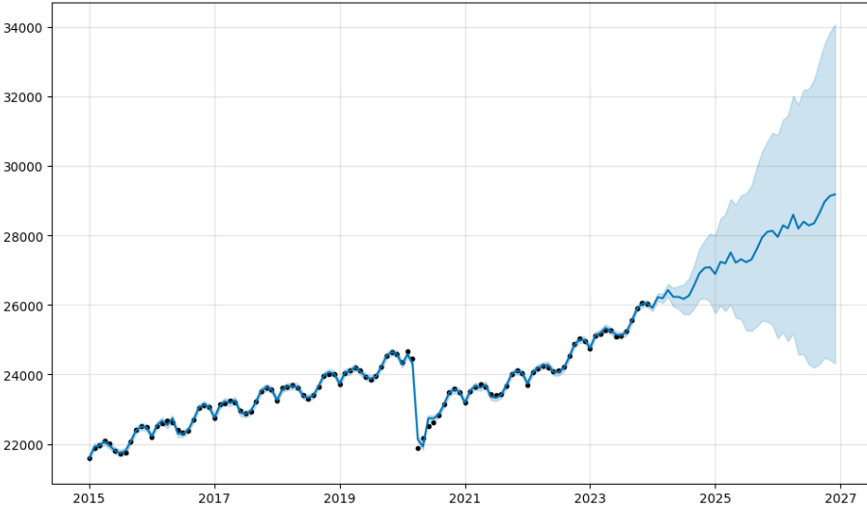
Health and Education Employment Forecast
“AI technologies will be a source of enormous power for the companies and countries that harness them.” -NSCAI
Analysis Highlights
Overall employment was trending upwards until 2020
Job loss was not as significant as it was in the government industry, and it recovered much faster, reaching pre-pandemic levels by early 2023
Employment
Year
Notes:
Computer and mathematical occupations (15%) & $100k median annual wage
Healthcare occupations (15%) & $30k median annual wage

Slide 15
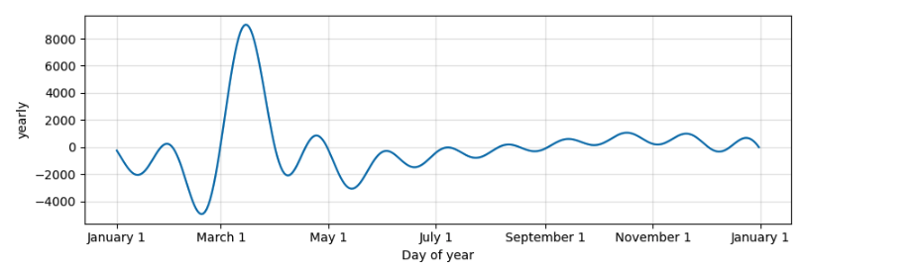
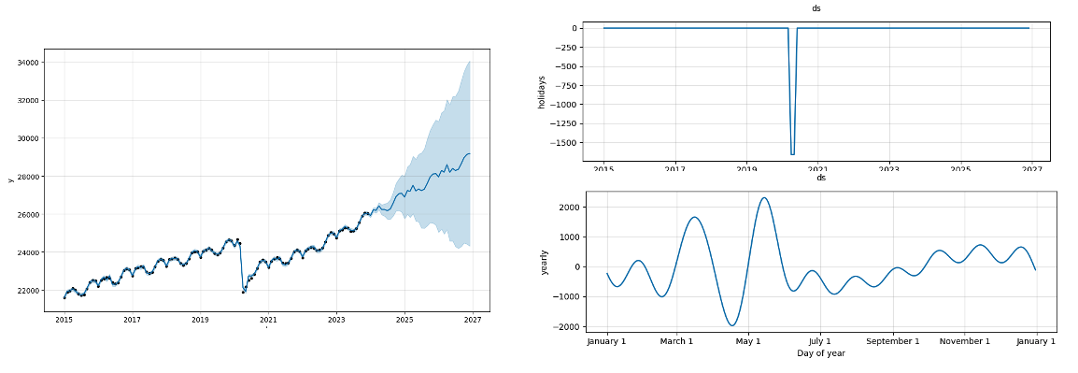
HEALTHCARE & EDUCATION INDUSTRY
Source: Bureau of Labor Statistics (2023)

Slide 16
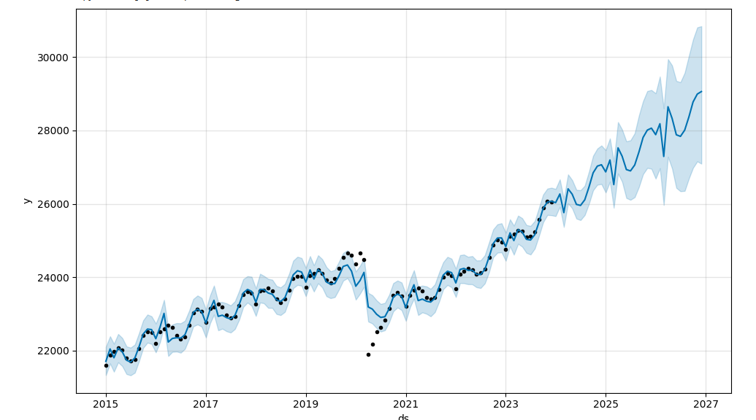
Health and Education Employment Forecast
“AI technologies will be a source of enormous power for the companies and countries that harness them.” -NSCAI
Analysis Highlights
Overall employment was trending upwards until 2020
Job loss was not as significant as it was in the government industry, and it recovered much faster, reaching pre-pandemic levels by early 2023
Employment
Year
Notes:
Computer and mathematical occupations (15%) & $100k median annual wage
Healthcare occupations (15%) & $30k median annual wage

Slide 17
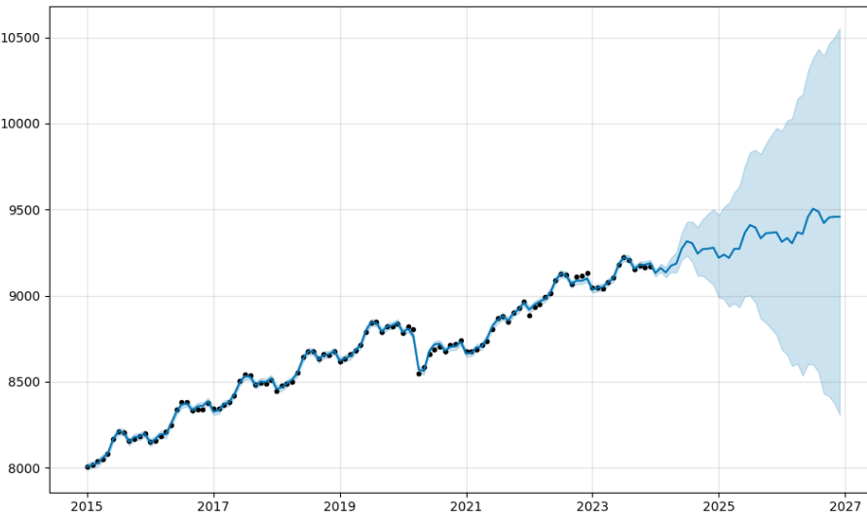
Financial Activities Employment Forecast
“Emerging technologies led by AI now underpin our economic prosperity, security, and welfare.” -NSCAI
Analysis Highlights
We see significantly fewer jobs overall than in Government and Health and Education sectors;
Employment trends are similar to the other industries in that employment was trending upwards, dipped in 2020 (with a loss of less than 500,000) jobs
Reaching and exceeding pre-pandemic levels in 2021
Employment
Year
Notes:
Computer and mathematical occupations (15%) & $100k median annual wage
Healthcare occupations (15%) & $30k median annual wage

Slide 18
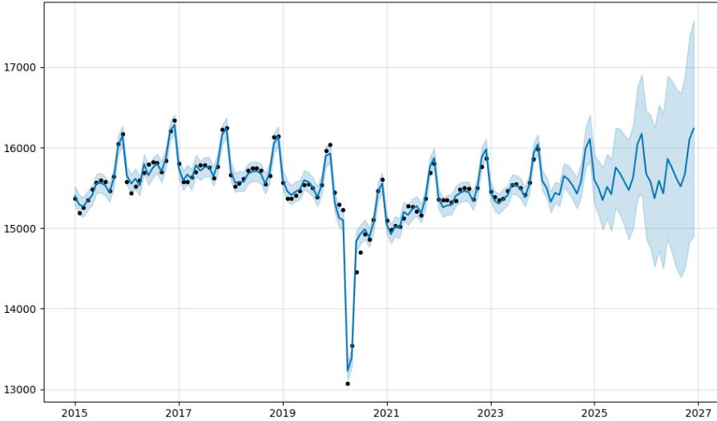
Retail Trade Employment Forecast
“We regard talent as the most essential requirement [for AI] because it drives the creation and management of all the other elements.” -NSCAI
Analysis Highlights
Employs fewer full-time workers than either the Government or Healthcare and Education industries
More people are employed than within the Financial industry
Retail employment was declining before 2020 and may not yet reach 2019 employment levels until this year
Employment
Year
Notes:
The dataset reflects employment trends in the retail industry, showcasing the number of full-time employees over the past few years. Over the observed period, there is noticeable variability in employment figures, with fluctuations from month to month. In recent months, the industry experienced a decline, possibly influenced by economic factors, seasonal variations, or other external factors. The data highlights the dynamic nature of the retail job market, with fluctuations possibly influenced by factors such as consumer demand, economic conditions, or industry-specific events. Analyzing these trends could offer valuable insights for businesses and policymakers in adapting strategies to the ever-changing landscape of the retail sector.

Slide 19
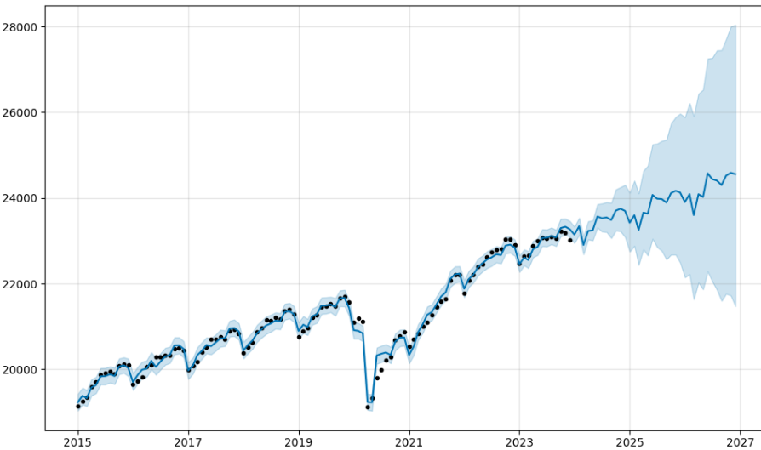
Professional & Business Services Forecast
“In 2020, there were more than 430,000 open computer science jobs in the United States, while only 71,000 new computer scientists graduate from American universities each year.” -NSCAI
Analysis Highlights
With Professional and Business Services, we see similar overall employment numbers to Government and Health and Education
We also see a swift post-pandemic recovery period similar to the Financial industry
Reaching pre-pandemic employment levels mid-2021
Employment
Year
Notes:
This graph reflects the monthly variations in full-time employees from September 2015 to December 2023. Over the period, the industry experienced a general upward trend in the number of employees, with occasional fluctuations. Notable peaks in employee numbers occurred in November 2018 and December 2023, while there were declines in January 2016 and May 2020. Seasonal patterns are evident, with recurring increases and decreases in specific months. Recent months show a stable workforce, but it's crucial to consider external factors or organizational changes that may influence these trends. Overall, the data suggests a dynamic employment landscape.

Slide 20
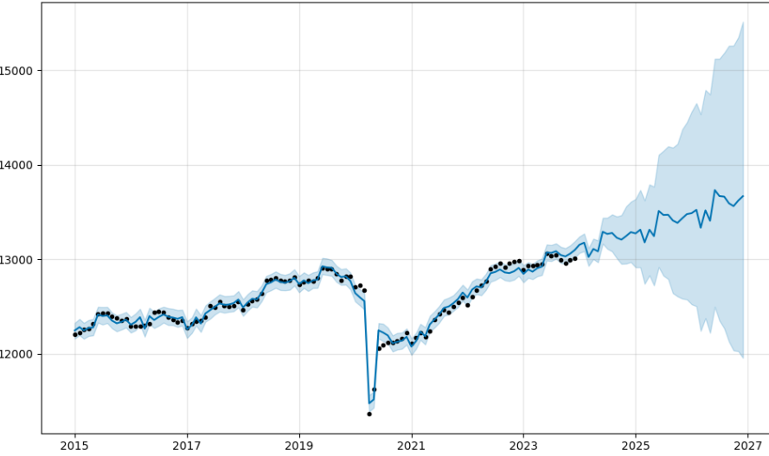
Manufacturing Employment Forecast
“The artificial intelligence (AI) competition will not be won by the side with the best technology. It will be won by the side with the best most diverse and tech-savvy talent.” -NSCAI
Analysis Highlights
At a peak of 13,000,000 full-time employees in 2019, manufacturing employs the 2nd lowest number of FTEs from the industries we’ve reviewed
Unlike Financial Services, Manufacturing didn’t reach pre-pandemic employment levels until 2023
Expected to increase by less than 1,000,000 jobs by 2027
Employment
Year
Notes:
This graph illustrates the employment trends within the Manufacturing industry from September 2015 to December 2023. Overall, the industry has maintained a relatively stable workforce, with minor fluctuations observed over the years. December 2023 recorded the highest number of employees at 13,013, indicating potential growth or seasonal patterns. Noteworthy declines were observed in May 2020, with employment dropping to 11,366, influenced by the challenges posed by the global pandemic. Seasonal variations are evident, with employment typically peaking towards the end of the year.

Slide 21

WHAT WE LEARNED
This Photo by Unknown Author is licensed under CC BY-SA-NC
Notes:
Ab

Slide 22
RESULTS & CONCLUSIONS
Access BLS data via API and how to use Prophet to analyze time-series data
Computer science is one of the top 2 growing occupations
Computer scientists have a median income at 2-3x the other similarly fast-growing occupation
Healthcare and Education and Business and Professional Services industries employ the most people
Now is the best time to be in AI
Notes:
The labor market trends suggest a promising outlook for individuals in computer science, which ranks among the top two fastest-growing occupations. Computer scientists enjoy a median income significantly higher, ranging from 2 to 3 times more than other similarly fast-growing occupations. The Healthcare, Education, and Business and Professional Services industries emerge as the largest employers, reflecting substantial workforce demands. Accessing data from the Bureau of Labor Statistics (BLS) via API can provide valuable insights into employment, wages, and occupational trends. To analyze time-series data, the use of Prophet, an open-source forecasting tool by Facebook, is recommended. Utilizing this tool involves structuring the dataset with 'ds' for dates and 'y' for values, fitting the model, and making predictions for future periods. Overall, these trends indicate a favorable environment for individuals in AI, with the field's significance evident across industries and making it an opportune time to be involved in artificial intelligence.

Slide 23

FUTURE RESEARCH
Notes:
Ab

Slide 24
AREAS TO EXPLORE WITH FUTURE RESEARCH
What are the most desirable skillsets (for programmers and non-programmers) within the field of artificial intelligence for the next 2-5 years?
Where are the best places to live and work in for artificial intelligence jobs, if remote work isn’t an option?
Will Kadoa be a good source for our classmates to review new job postings and ultimately secure a new role in artificial intelligence?
How might we connect with government agencies who are seeking to build a new civilian workforce, as recommended by the NSCAI?

Slide 25

Q&A

Slide 26


Slide 27
Appendix
REFERENCES & SUPPLEMENTARY VISUALIZATIONS OF BLS DATA

Slide 28
References
Bureau of Labor Statistics. (2023, December 5). 10 major occupational groups with higher-than-average wages projected to grow faster than average. Retrieved from https://www.bls.gov/opub/ted/2023/10-major-occupational-groups-with-higher-than-average-wages-are-projected-to-grow-faster-than-average.htm
Bureau of Labor Statistics. (2023). Data extracted from the Bureau of Labor Statistics API. Retrieved from https://www.bls.gov/developers/api_python.htm
Council of Economic Advisors. (2022, December 5). The impact of artificial intelligence on the future of workforces in the European Union and the United States of America. Retrieved from https://www.whitehouse.gov/wp-content/uploads/2022/12/TTC-EC-CEA-AI-Report-12052022-1.pdf
LinkedIn. (n.d.). Job listings for 'artificial intelligence'. Retrieved 2023, January 8, from https://www.linkedin.jobs.com
The National Security Commission on Artificial Intelligence. (2021, October 5). 2021 Final Report. Retrieved from https://cybercemetery.unt.edu/nscai/20211005220409/https://reports.nscai.gov/final-report/table-of-contents/
Smith, M. (2023, November 2). The most in-demand AI job of 2023 can pay over $200,000 and offers remote opportunities. CNBC.com. Retrieved from https://www.cnbc.com/2023/11/02/the-most-in-demand-ai-job-of-2023-can-pay-over-200000-and-offers-remote-opportunities.html

Slide 29
HEALTHCARE & EDUCATION INDUSTRY
Source: Bureau of Labor Statistics (2023)

Slide 30
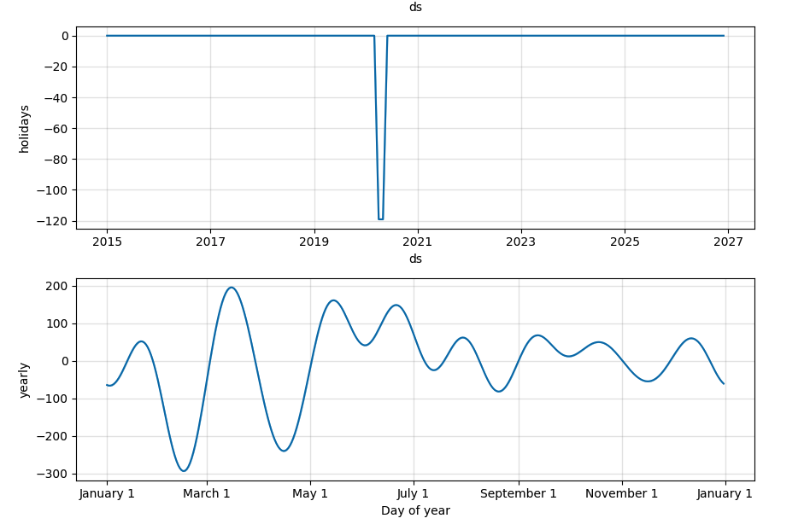
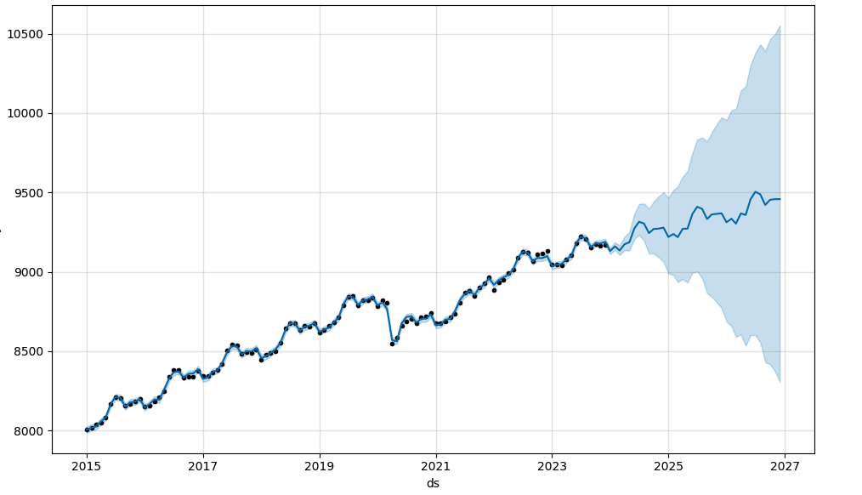
FINANCIAL ACTIVITIES INDUSTRY
Source: Bureau of Labor Statistics (2023)

Slide 31
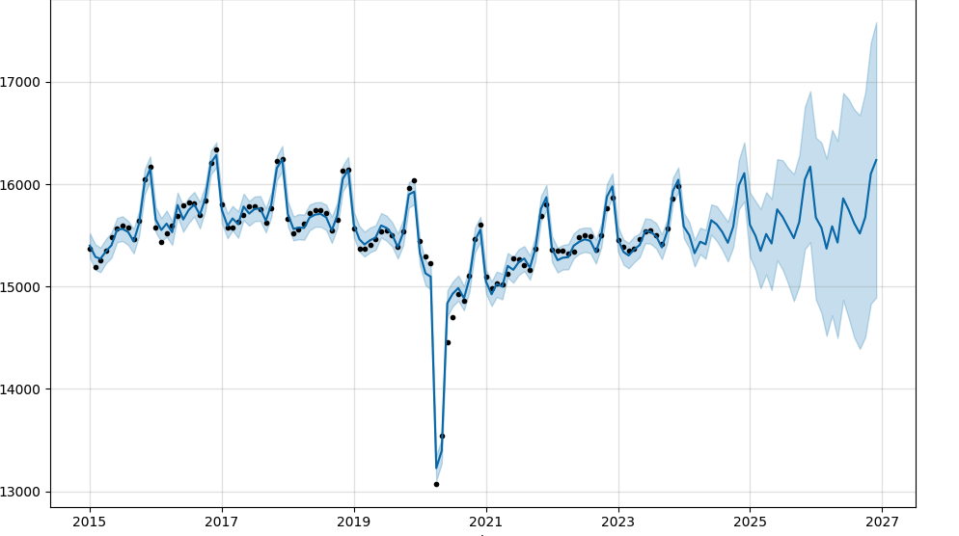
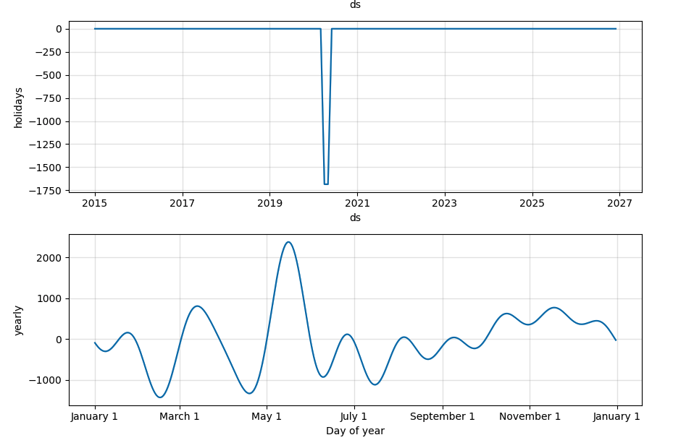
RETAIL INDUSTRY
Source: Bureau of Labor Statistics (2023)

Slide 32
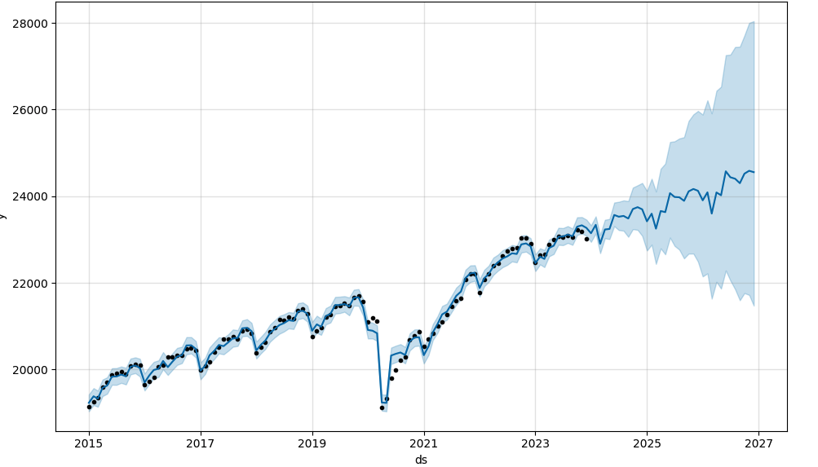
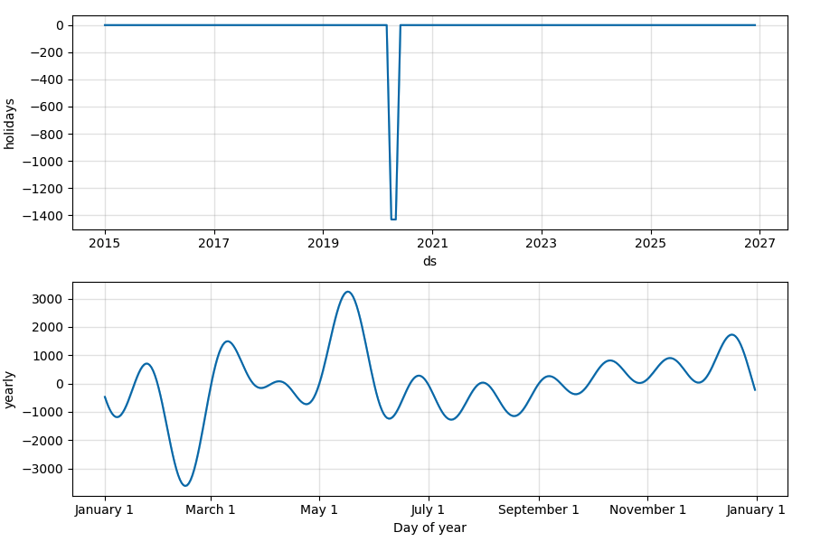
PROFESSIONAL & BUSINESS SERVICES INDUSTRY
Source: Bureau of Labor Statistics (2023)

Slide 33
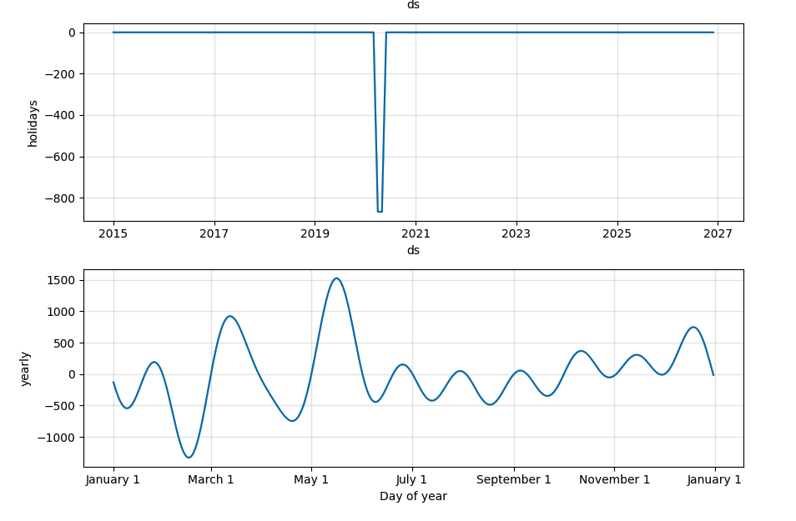
MANUFACTURING INDUSTRY
Source: Bureau of Labor Statistics (2023)

